Slide 1

UXJourney
the
The process to optimize your resource for the quality User Requirement
ISMAIL WAHYU FADILAH
202010370311339
CLASS 7D
W R I T T E N B Y H C I G R O U P

Slide 2
UXJourney
the
The process to optimize your resource for the Requirement quality User
Second Versions
Written by HCI Group
Universitas Muhammadiyah Malang and Universiti putra malaysia
Wahyu Andhyka Kusuma Azrul Hazri bin Jantan Novia Admodisastro Noris Mohd Norowi

Slide 3
UXJourney
the
The process to optimize your resource for the quality User Requirement
The UX journey is a process that helps optimize resources for quality user requirements while improving self-efficacy. The process involves a series of steps that begin with understanding the user's needs and expectations. This includes research to gain insights into the user's goals, motivations, and pain points. Once the user's needs have been identified, the next step is to develop a user persona, which is a detailed description of the user's characteristics, preferences, and behaviors. This persona serves as a reference point throughout the UX design process.
The next step in the UX journey is to define the user journey, which is the user's path to achieving their goals. This includes mapping out the steps involved in the user's interactions with the product or service and identifying potential pain points or areas for improvement.
Once the user journey has been defined, the UX designer can prototype and test different solutions. This involves creating wireframes, mockups, and prototypes of the product or service and testing these designs with users to gather feedback and identify areas for improvement.
Throughout the UX journey, it is important to focus on the user’s needs and expectations and continuously iterate and improve the design based on feedback and testing. By following this process, designers can optimize their resources to deliver quality user requirements while building their self-efficacy and confidence in their design decisions.

Slide 4

Hello
This is my UX Diary
PLACE YOUR
PHOTO
HERE
Tell me about your personality and ability
Hello, I'm Ismail Wahyu Fadilah, or usually called Fadilah. I am a student of the Bachelor of Literature 1 Informatics Engineering Program at the University of Muhammadiyah Malang with NIM 202010370311339.
I have a great interest in model design techniques, especially in the context of user experience (UX). I believe that UX plays an important role in producing a product or system that is more functional, efficient and satisfying for end users.
I continue to strive to deepen my knowledge and skills in the UX journey through learning on campus and also through activities outside the classroom. I am very enthusiastic about continuing to contribute to the development of products or systems that can improve the quality of user experience

Slide 5
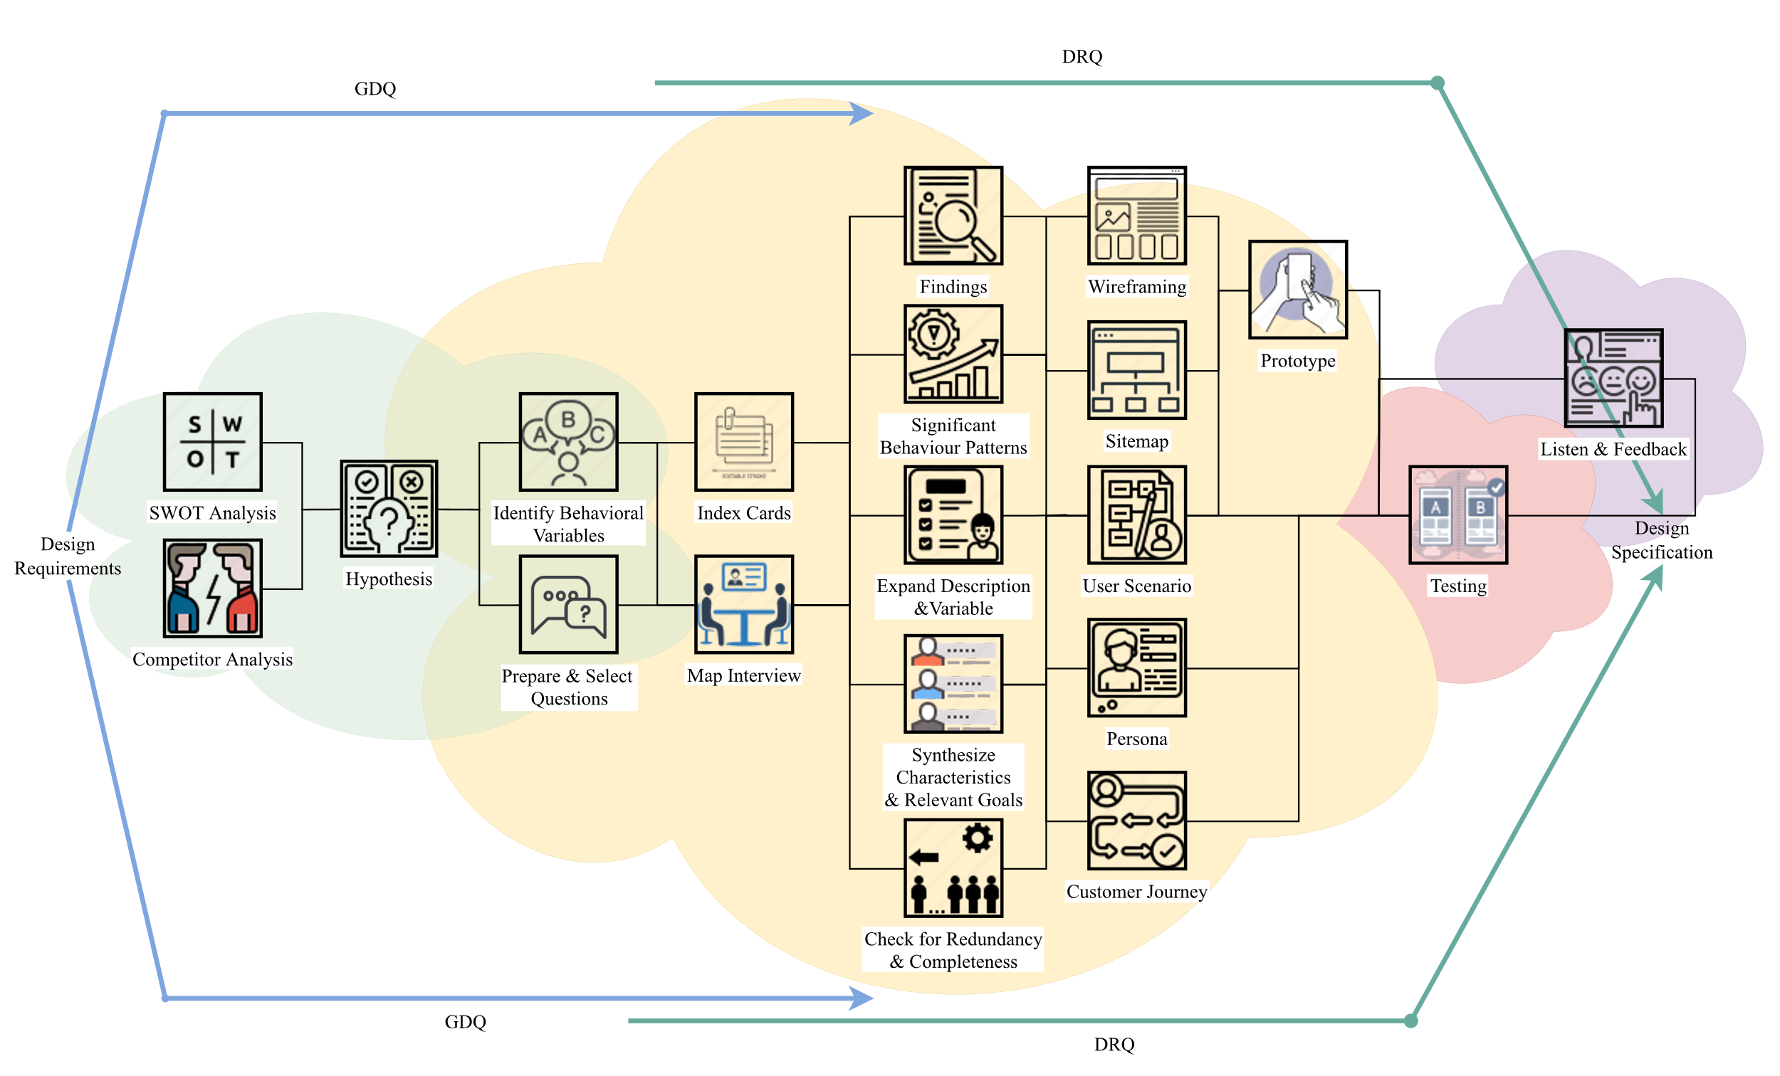
UXJourney
the
The process to optimize your resource for the quality User Requirement

Slide 6
UX Journey Activities Checklist
Activity | Time* | Activity | Time*
(D) Discover |  | Expand the Description of Attributes and Behavior | 4
Field studies | 20 | Persona | 16
SWOT Analysis | 60 | Journey Mapping | 50
Competitor Analysis | 6 | User Scenario and Stories | 13
State hypotheses | 14 | Sitemap | 2
Identify Behavioral Variables | 2 | Wireframing | 16
(E) Explore |  | (T) Test
Prepare Questions | 8 | Quantitative & Qualitative Usability Testing | 12
Meet Stakeholder | 8 | A/B Testing | 30
Index Card | 16 | Objective Verification | 4
Map Interview Subjects to Behavioral Variables | 16 | Variable Verification | 4
Identify Significant Behavior Patterns | 4 | Acceptance Criteria | 45
Synthesize Characteristics and Relevant Goals | 8 | (L) Listen
Check for Redundancy and Completeness | 8 | Follow up | 10
*Time in minutes

Slide 7
My Goals
10
Kickstart Project | Day 1 Study the material will work on project B and prepare materials that will be included in the document | Day 2 Complete and documenting personality and abilities, UX journalism activities checklist, and My Goals | Day 3 Complete and document Field Studies, SWOT, and Competitors
Time allocation
Day 4 Complete and document Hypothesis, Identify Behavioral Variables and Prepared Questions | Day 5 Complete documenting stakeholder meetings and findings | Day 6 Complete and document the Index Card and Map Interview | Day 7 Resolve and document Significant behavior patterns
Day 8 Complete and document Synthesize characteristics and check for redundancy | Day 9 Complete and document validation, verification and expand description | Day 10 Complete and document personas, custom journeys, and user scenarios | Day 11 Complete and document site map, wire framing and qualitative
Day 12 Complete and document A/B Testing, Verification and objective behavioral variables | Day 13 Complete and document acceptance criteria and follow up | Day 14 Submit Project | Deliver Project

Slide 8



Slide 9
Field studies
20
The development of information technology has changed the way we carry out many daily activities, including searching for and ordering construction services. Ordering traditional construction services often takes time and effort, and there are often misunderstandings between users and builders resulting in incompatibility of user project designs with many obstacles such as difficulty looking for a craftsman who suits your needs, price uncertainty and limitations available information.
In this context, the development of an application for ordering construction services becomes increasingly relevant and necessary. This application has the potential to simplify and simplify the process of ordering construction services, as well as making things easier visualize the design, Reduce misunderstandings and ensure project suitability with expectations.
This study aims to gain in-depth insight into the experience user (UX) in using the "Lebusier" application to order construction services and use building design features. The aim of this study is to confirm that the application provides an intuitive, efficient and satisfying user experience. It is hoped that this study will produce an in-depth understanding of the user experience in using the "Lebusier" application to order construction services and use building design features. The results of this study will guide the team development in designing and optimizing applications to meet

Slide 10
SWOT analysis
60
Strength
Advantages? | Makes development project planning easier
Uniqueness? | The presence of building design features to design and visualize projects easily
Selling Points? | There is a search for craftsmen who are selected through a selection process and guarantee the quality of the work
Skills? | Ability to understand and implement development planning with tutorial features
Other factors? | Security of user privacy data
Weaknesses
Limitations? | Builders' availability may be limited depending on location or their own schedule
Lack of effort? | Even though there are home design features, there is a risk that the final result of the design will not match the user's expectations.
Problems? | Difficulty in managing large construction projects, because they are basically made for customer needs in making private developments
Poor strategy? | Lack of cost calculations that optimize discussions with builders
Other factors? | Limited availability of materials depends on the location of the supplier
Opportunities
Improvements? | The market for applications for ordering construction services and home design solutions will continue to grow along with advances in digital technology in the Potential to expand th
Performance? | otential to expand the range of applications to areas with minimal development construction industry where construction and home design services are needed
Opportunities? | Established a partnership with Building Stores to provide users with direct access to purchase their materials
Consumer behavior? | Offers additional services such as repairs to each building unit with many discounts
Other factors? | Target specific market segments such as home renovation projects, commercial construction, or green construction projects to meet specific user needs.
Threats
External trouble? | The presence of superior competitors with similar solutions can influence the development and acceptance of applications
obstacles? | There are competitors who have the same uniqueness as this application
Trends? | Registered builders not meeting quality standards creates a risk to user satisfaction
Other factors? | Users who are dissatisfied with the services provided can switch to competing applications.

Slide 11
Competitor
6
DIRECT COMPETITION
INDIRECT COMPETITION
Gravel
Kanggo
Sejasa
Seekmi
Ayorenovasi.com
USER REVIEWS
The direct and indirect view of the application for ordering construction services with the "Libusier" house building design is that there are still deficiencies in the quality of the construction workers because they are not very skilled in handling the project being carried out. That way there must be a mechanism to verify the qualifications and experience of builders before they register. So that the builders produced from this application are the builders of choice with the expected work results and satisfying customers

Slide 12
Hypotheses
10
HYPOTHESES PERSONAS
EXPLANATION
HPS 1
HPS 2
HPS 3
HPS 4
HPS 5
Meylinda
Anang
Rudi
Yoga
Hafidz
A civil servant who wants to build his private house, he needs the help of an application that can find construction workers with good quality according to his portfolio, he also wants a platform that provides furniture in collaboration with several well-known partners.
A private worker who is building his dream house. He wanted to make a house according to his desired needs and made plans with a builder which was easy with just an application
A construction worker who wants to expand his client reach. He was looking for an app that could market his skills and get access to new projects.
A young shipboard worker has just bought a house and wants to do major renovations. He was looking for an app that could help him find a trustworthy builder with a strong portfolio to help renovate his dream home into a reality
A small entrepreneur who wants to continue his parents' business by building a new office for his business. But he needed design help to ensure that the space suited his needs. He is looking for an application that has features for designing a house along with ordering construction services

Slide 13
Hypotheses Explanation
6
Explanation of the Hypothesis resulting from observations of several personas by discussing the "Lebusier" application, namely, solving their dream Home Design. Several personas are interested in this application because they believe that the building design features will help them visualize their construction project better before starting. Ease of communication with users and workers the builder who created them to understand and demonstrate the need project clearly. Providing access to the latest information in construction material information, techniques and other resources that can help users make decisions better in their construction projects. This hypothesis clarifies the basis for planning and measuring applications in the development and launch stages in which the user experience can meet and exceed user expectations.

Slide 14
Identify Behavioral Variables
2
OBSERVED BEHAVIORAL VARIABLE
SCALE
Level of difficulty in searching for a builder
Level of user satisfaction in visualizing the building
The level of difficulty in finding repairs and materials building
Level of difficulty in understanding building planning
Level of user satisfaction in using the application
(Hard-Easy)
(Not Satisfied)
(Hard-Easy)
(Hard-Easy)
(Not Satisfied)

Slide 15
Variable Explanation
6
With the search feature for builders through selection make it easier for your project needs?
Are you satisfied with the home design features in visualizing? your construction project better?
Do you find it difficult to search for building repairs and materials? buildings in this application?
Is it easy for you to understand building planning in this application?
Do you find it easy to use the meet with builders feature to consult on the project design you want?

Slide 16


Slide 17
1 5-minute prepare questions
8
2 Minutes | Welcome Remarks | 1. Asslamu'alaikum, let me introduce myself, my name is Ismail Wahyu Fadilah, I am a UMM Informatics Engineering student, I would like to conduct an interview with you to seek opinions for the application system for ordering construction services
2 Minutes | Collect demographics | 2. You are allowed to introduce yourself first
2 Minutes | Tell a story | 3. Have you ever used an online construction services ordering application before? If so, maybe you can tell me about the good and bad experiences you had.
2 Minutes | Problem ranking | 4. The following are related to the problems that exist as a user, in your opinion, which problems are common to worst, try them in order: • Difficulty finding qualified builders • It is difficult to describe the shape of the house we want with the builder • Lack of correct building planning information • Limited search for building materials nearby
3 Minutes | Explore customer's word view | 5. Regarding the use of the application, is there anything that makes it difficult for users to use the application or is there anything that might be added to become an additional feature in the application?
2 Minutes | Wrapping up | 6. Maybe that's all for the interview session I'm conducting this time, thank you for being a resource for the process of creating my application system
2 Minutes | Document results | 7. The documents resulting from this interview are used as consideration before making a better application.

Slide 18
Prepared questions
8
With the feature of searching for builders through selection, does it make it easier for your project needs?
Are you satisfied with the home design features to better visualize construction projects?
Do you find it difficult to search for building repairs and building materials in this application??
Do you find it easy to understand building planning in this application?
Do you feel satisfied in creating your development project in this application?

Slide 19
Creativity is intelligence having fun
Albert Einstein

Slide 20
Meet stakeholder
8
OBJECTIVE AND EXPECTED RESULTS
Make it easier to understand the problems experienced by stakeholders and provide solutions that can solve the problems experienced by stakeholders through an application system that I will create.
5 MINUTES QUESTIONS
With the search feature for builders through selection make it easier for your project needs?
Are you satisfied with the home design features in visualizing? your construction project better?
Do you find it difficult to search for building repairs and materials? buildings in this application?
Is it easy for you to understand building planning in this application?
Do you feel satisfied in creating your development project in this application?

Slide 21
Findings
8
MENTION YOUR FINDINGS
Most users find it easy with the experience of using the application in choosing a builder through this platform.
MENTION YOUR FINDINGS
Because many users are satisfied using the home design feature for
visualize their construction project before selecting a builder
MENTION YOUR FINDINGS
The majority of users show satisfaction with this application
MENTION YOUR FINDINGS
More and more builders are signing up and using the platform, demonstrating its appeal and benefits for construction professionals.

Slide 22


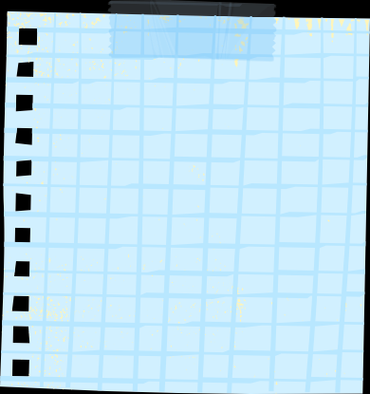


Persona name: Meylinda
16
Integrate a builder search feature based on their specialization and portfolio. This will help users like Meylinda find the right professional
Integrate a builder search feature based on their specialization and portfolio. This will help users like Meylinda find the right professional
Collaboration with well-known furniture brands to provide exclusive product catalogues. Users can browse and purchase furniture according to their preferences.
Add the option to contact the customer support team if Meylinda experiences any problems or needs help during the project
Update user profiles with the option to save and share design ideas or inspiration for their home
Update user profiles with the option to save and share design ideas or inspiration for their home
Add the option to contact the customer support team if Meylinda experiences any problems or needs help during the project
Integrate a schedule alert feature (Reminder) to ensure that Meylinda doesn't miss important meetings or deadlines during the project
Share your idea, write in this notes

Slide 23
Persona name: Anang
16
Add the option to leave a review and rating for the builder after the project is complete. This will help other users in choosing the right professional
Add a chat or direct message feature between Anang and the builder to make communication easier throughout the project
project calendar feature that can help Anang track important schedules and deadlines during the construction process
Create a feature to upload project-related documents and images, such as sketches or visual references
Share your idea, write in this notes

Slide 24
Persona name:
Rudi
16
Sediakan fitur notifikasi untuk memberi tahu Rudi tentang proyek baru atau permintaan dari klien potensial yang sesuai dengan keterampilannya
Integrate a bidding or price quote system that allows Rudi to provide project cost estimates quickly and accurately
Add a calendar availability feature to allow Rudi to update his work schedule and confirm his availability for new projects
Create a forum or community in the app to allow construction professionals like Rudi to share tips and experiences in the industry
Share your idea, write in this notes

Slide 25
Persona name:
Yoga
16
Create a forum or community in the app to allow construction professionals like Rudi to share tips and experiences in the industry
Make sure the builder has experience with similar projects. Check portfolios and reviews before choosing
Schedule a meeting with the builder to discuss renovation plans. Set realistic deadlines
Make sure permits and legal requirements are met before starting the project. Check local regulations regarding home renovations
Share your idea, write in this notes

Slide 26
If a User is having a problem, it's our problem.
Steve Jobs

Slide 27
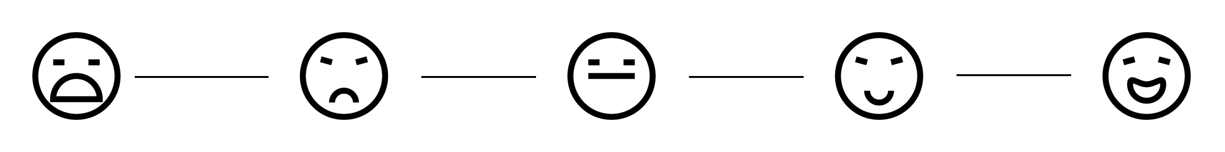
Map Interview
16
USER FEELING
Persona:
Variable: 1. With the feature of searching for builders through selection, does it make it easier for you to meet your project needs?
Scale 1: Easy | Scale 2: | Scale 3: Just Normal | Scale 4: | Scale 5: Easy
Respondent: 1. 2. | Respondent: 1. 2. | Respondent: 1. 2. | Respondent: 1. 2. | Respondent: 1. 2.
Variable: 2. Are you satisfied with the interior design features of the house? : visualize your construction project better?
Scale 1: Not Satisfied | Scale 2: | Scale 3: Just normal | Scale 4: | Scale 5: satisfied
Respondent: 1. 2. | Respondent: 1. 2. | Respondent: 1. 2. | Respondent: 1. 2. | Respondent: 1. 2.

Slide 28
Map Interview
16
USER FEELING
Persona:
Variable: 3. Do you find it easy to search for repairs buildings and building materials in this application?
Scale 1: Dificult | Scale 2: | Scale 3: Just normal | Scale 4: | Scale 5: Easy
Respondent: 1. 2. | Respondent: 1. 2. | Respondent: 1. 2. | Respondent: 1. 2. | Respondent: 1. 2.
Variable: 4. Do you find it easy to understand building planning in this application?
Scale 1: Dificult | Scale 2: | Scale 3: Just normal | Scale 4: | Scale 5: Easy
Respondent: 1. 2. | Respondent: 1. 2. | Respondent: 1. 2. | Respondent: 1. 2. | Respondent: 1. 2.
Variable: 5. Do you feel satisfied in creating your development project in this application?
Scale 1: Not Satisfied | Scale 2: | Scale 3: Just normal | Scale 4: | Scale 5: satisfied
Respondent: 1. 2. | Respondent: 1. 2. | Respondent: 1. 2. | Respondent: 1. 2. | Respondent: 1. 2.

Slide 29
Significant Behaviour Patterns
2
OBSERVED BEHAVIORAL VARIABLE
SCALE
PERCENTAGE
With the search feature for builders through selection make it easier for your project needs?
Are you satisfied with the home design features in visualizing construction projects better?
Do you find it difficult to do search for building repairs and building materials in this application??
Do you easily understand planning? buildings in this application?
Do you feel satisfied in creating your development project in this application?
Easy Just normal Difficult
Satisfied Just normal Not satisfied
Easy Just normal Difficult
Easy Just normal Difficult
Satisfied Just normal Not satisfied
100% 0% 0%
80% 20% 0%
80% 20% 0%
60% 40 % 0%
80 % 20 % 0%

Slide 30
Pattern Explanation
6
Explain the percentage results from interview results to personas :
First variable: 100% answered Happy, 0% answered Neutral, 0% answered Not Happy..
Second Variable: 80% answered Happy, 20% answered Neutral, 0% answered Not Happy.
Third variable: 80% answered Happy, 20% answered Neutral, 0% answered Not happy
Fourth variable: 60% answered Happy, 40% answered Neutral, 0% answered Not Happy.
Fifth variable: 80% answered Happy, 20% answered Neutral, 0% answered Not Happy.

Slide 31





Synthesize Characteristics And Relevant Goals
8
PATTERN
Persona:
Variable: 1
 | 100% | ___% | ___% | ___% | ___%
Variable: 2
 | 80% | ___% | 20% | ___% | ___%
Variable: 3
 | 80% | ___% | 20% | ___% | ___%
Variable: 4
 | 60% | ___% | 40% | ___% | ___%
Variable: 5
 | 80% | ___% | 20% | ___% | ___%

Slide 32
Synthesize Explanation
14
Based on the SYNTHESIS CHARACTERISTIC AND RELEVANT GOAL data, the following patterns were obtained
the explanation is as follows:
Variable 1, For stakeholders there are 100% personas which are made easier by the search feature for recommended craftsmen to fulfill their project work.
Variable 2, among stakeholders, there are 80% of personas who are satisfied that the building design features in the building services ordering application help them visualize their projects for builders. 20% felt normal about this feature.
Variable 3, among stakeholders, there are 80% of personas who are satisfied that the building design features in the building services ordering application help them visualize their projects for builders. 20% felt normal about this feature.
Variable 4, 60% of stakeholders realize that this application is easy to use. but 40%% of the personas are average on this issue.
Variable 5, among stakeholders, there are 80% of personas who feel the effectiveness of the Le Busier application when used to help work on their building projects. However, 20% of people feel normal about this problem.

Slide 33
Want your
users to fall in
love with your
designs? Fall in
love with your users.
Dana Chisnell

Slide 34
Check for Redundancy and Completeness
2
Is there anything missing from the personas mappings, characteristics and objectives that needs to be added?
If so, please specify: No
To satisfy stakeholder assumptions or requests, does any other persona need to be added?
If so, please specify which persona should be added:
Are they any two personas that differ only as to social-demographic variables?
If so, please specify what decision is to be taken:
Remove one of the personas. If so, specify which one:
Examine characteristics more thoroughly and differentiate personas.:
Are all created personas significantly different?
If so, please state which personas are alike:
Overall, are the created personas representative enough of the diversity of real-world behavior and needs?
Yes, because the existing personas that have been used have fulfilled the research to be explored responsiveness

Slide 35
Expand Description and Variable
4
TODAY I AM FEELING...
More Spirit
TODAY I AM GOTING TO...
Prepare Your Needs
TODAY I AM LOOKING FORWARD TO...
Today and afterward I will read a lot of journals
MY AFFIRMATION TODAY
Pursue the future as if you still have 1000 years to live and worship as if you have only 1 day left to live

Slide 36
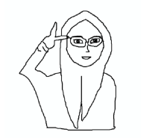
Persona
16
Persona name: Meylinda
Roles & tasks:User Apps
Age: 28
Profession: Notary Public
User quote:
continue to be ambitious with the spirit of 45
Personality traits/ behaviour: People who need personal help in making their personal home
project but have difficulty finding the services of a builder.
Lifestyle:
Motivation: Keep Going
Skill & Knowledge:
Novice (browsing, email)
Intermediate (social media)
Proficient (manage website)
Expert (programing complex web)
Authority (publish influential research)
Other Skill & Knowledge:
Segment:
Want to order construction services
also easy to adjust to needs
what he wanted
Sketch persona:

Slide 37
To create a memorable design, you need to start with a thought that’s worth
remembering.
Thomas Manss

Slide 38




Customer Journey Mapping
50
1
Decide on a target customer persona and the scope of the journey to be explored today.
Give them a visual representation, name and description.
2
Use sticky notes to build a back story, including the customer's reasons for taking this particular journey.
3
Ideally, 1 persona = 1 journey map. Duplicate these pages to repeat the exercise for another persona.
Key Attribute
Short Description
Meylinda
A civil servant who wants to build his private house, but has difficulty finding the best builder in his field
Add your thought here
Add your thought here
Persona 1 [Insert persona's name here]
Needs
Challenges
Meylinda needs an integrated platform with a search for craftsmen based on specialization and a complete portfolio to find the right professional craftsman
Understanding the driving factors in using the application and selecting a builder is the key to enabling involvement in safety, comfort and quality factors
Add your thought here
Add your thought here
Opportunities
Improved Design Functionality by providing more tools and design options that allow users to design their homes in greater detail. providing a step by step guide using tutorials on how to start a construction or home design project. There is an option to save previous preferences and designs for easy access for future projects.
Add your thought here

Slide 39




50
Persona 1
4
Describe the persona's journey in the first 3 rows, using one sticky note per action. "User actions" pertain to activities; "touchpoints" are interaction points like a website or email; and "pain points" refer to frustrations, errors and bottlenecks.
5
In the "emotions" row, move the dots up or down the colored spectrum to visually show how the persona's emotional experience rises and falls throughout the journey. Positive peaks = delight, while sudden drops = frustration.
6
In the final row, brainstorm possible solutions or areas of opportunity to improve the persona's experience.
Awareness
Consideration
Purchase
Onboarding
Advocacy
User Actions
Add your thought here
Building repair search menu
Building Design Menu
Material Purchase Menu
Tutorial and chat menu
Builder Search Menu
Add your thought here
Add your thought here
Add your thought here
Add your thought here
There are 2 menu options
search for a handyman
daily and wholesale
Click on the repair menu section in the main menu
Click on the Design Menu section in the main menu
Click on the Materials section
in the main menu
Click on the Tutorial and Chat Menu section
in the main menu
Touchpoints
Pain points
In the Tutorial menu, explanations are provided
just an introduction
about building construction
D e l i g h t e d
Emotions
F r u s t r a t e d
Possible Solutions

Slide 40
Usability rules the Web. If customers can't find a product, they will not buy it.
Jakob Nielsen

Slide 41
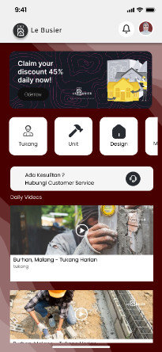
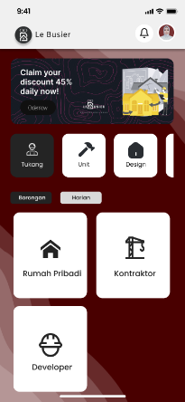
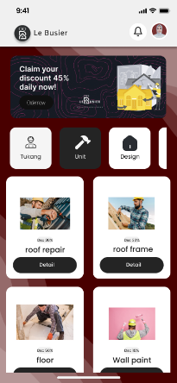
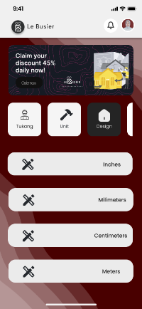
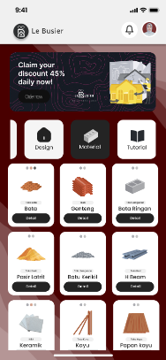
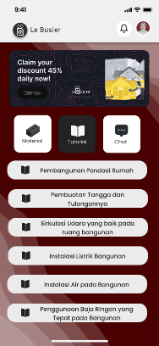
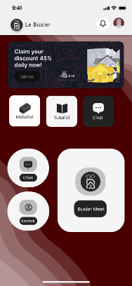
User Scenario and Stories
13
In the Tutorial menu, explanations are provided
just an introduction
about building construction
Personas can order daily or wholesale construction services from the handyman menu
In the unit menu, users can select unit repairs according to their needs
On the Design menu, users can select the dimensions of the building design
Personas can order materials in the material menu according to project needs
The Tutorial menu only displays
Information and steps regarding building project work
The Tutorial menu only displays
Information and steps regarding building project work

Slide 42
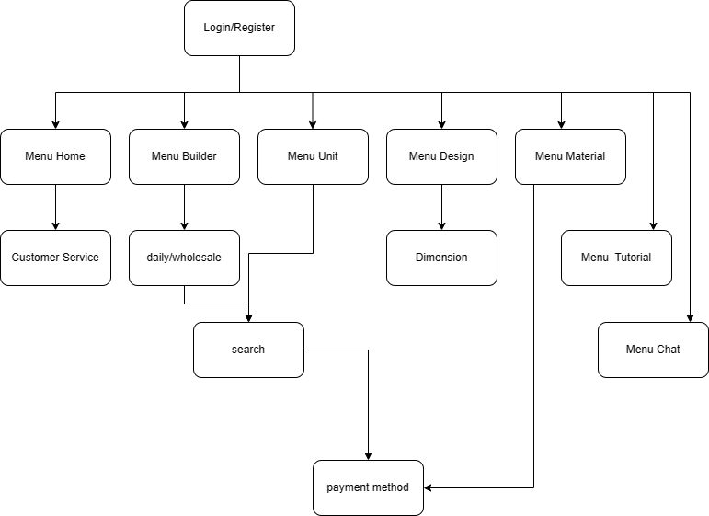
Sitemap
2

Slide 43

Wireframing
16
Screen name:
Main Menu
Component:
Logo Lebusier
Button Notification
Button Profile
Button Disc
Frame Disc
Button Icon Menu
Contact Person Customer Service
Daily Video
Heuristic violated:
The first display when the user enters the application

Slide 44

Wireframing
16
Screen name:
Menu Builder
Component:
Logo Lebusier
Button Notification
Button Profile
Frame Disc
Button Menu
Button Borongan
Button Harian
Button Select Choice 1 Rumah Pribadi, Kontraktor or Developer
Heuristic violated:
The first display when the user enters Builder menu

Slide 45
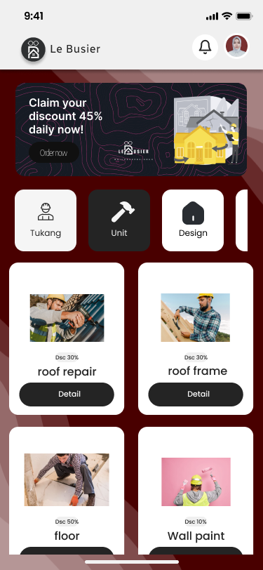
Wireframing
16
Screen name:
Unit Menu
Component:
Logo Lebusier
Button Notification
Button Profile
Frame Disc
Button Menu
Button Detail repair building
Heuristic violated:
The first display when the user enters the Unit Menu

Slide 46

Wireframing
16
Screen name:
Menu Design
Component:
Logo Lebusier
Button Notification
Button Profile
Frame Disc
Button Menu
Button Dimension Inchies
Button Dimension Milimeters
Button Dimension Centimeters and Meters
Heuristic violated:
When you click on the design menu

Slide 47


Slide 48

Qual & Quant
12
QUALITATIVE RESEARCH
QUANTITATIVE RESEARCH
Focus on "why"
Focus on "how many" & "how much"
Inform design decisions
Evaluate the usability of an existing site
Identify usability issuesand find solutions
Track usability over time
Findings based on the researcher’s impressions, interpretations, and prior knowledge
Compare site with competitors
USER REVIEWS
The reason I use quantitative research is because using this method can be done focusing more deeply on the experience and features for users. One of them Using AB Testing is a method that is suitable for checking the Lebusier application system whose function is to understand experience, identify needs, and serve as a comparison tool against similar systems with the latest application systems based on what is needed by
The reason I use quantitative research is because using this method it can be done more focusing deeply on the experience and features for users. One of them Using AB Testing is a method that is suitable for checking the Lebusier application systemwhose function is to understand experience, identify needs, and serve as a comparison tool against similar systems with the latest application systems based on what is needed by

Slide 49
AB Testing
30
Variable: 1
 | 80% | ___% | 20% | ___% | ___%
Variable: 2
 | 80% | ___% | 20% | ___% | ___%
Note:
Note:
In this prototype, users find it easier because of the appearance
initial menu that displays CS Contacts and the latest Daily Videos about construction world issues
In this prototype, users feel satisfied because it is easy with 2 options, namely wholesale or daily

Slide 50
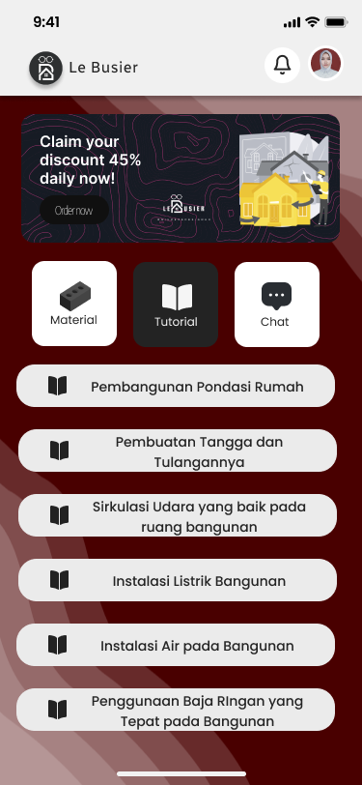
AB Testing
30
Variable: 1
 | 80% | ___% | ___% | ___% | 20%
Variable: 2
 | 100% | ___% | ___% | ___% | ___%
Note:
Note:
This prototype makes the user feel more
I'm happy because this display is simple and attractive
In this prototype the user feels satisfied
because the display selects dimensions, sizes, building design features, it is easier to understand and simpler.

Slide 51
Verification
4
PERSONAS
EXPLANATION
HYPOTHESES
H1
H2
H3
H4
H5
In this prototype the user feels satisfied because the display selects dimensions, sizes, building design features, it is easier to understand and simpler.
From the results of the system above, if a comparison test is carried out with similar applications, the user story is quite satisfied with the creation of an application with appropriate first page features, search for builders, unit repairs, building design, material shops, construction tutorials and partner communication chat. with what is expected by the user story and can function according to its use

Slide 52
Objective Explanation
4
My reason is that the first page is made with a simple menu displaying CS Contacts to make it easier for users to use this application and can ask questions if they have difficulties, sometimes there are users who need an introduction to building construction for the continuity of the building project they are going to make. For the handyman menu, I immediately display a contract or daily feature which allows you to adjust the type of order for handyman services based on the user's needs, whether the project being worked on is large or small. In the Unit menu, it shows many types of building unit repairs which make it easier for users to choose the type of work which is only different from the daily feature where daily people can freely choose building repair work but not in more detail because the craftsman they are looking for is automatically based on a craftsman whose skills are general, not a craftsman. who focus their expertise on one type of need. The building design menu section displays 4 options from which to select the dimensions and size of the user's design working drawings. For the user material menu, it is shown that there are many materials provided, some of which are in collaboration with well-known distributors such as IKEA and Informa. The tutorial menu displays some information regarding building construction stages starting from the basics for building project owners to know the correct stages when exchanging information with building construction services. and finally, this chat menu has 3 features in it, namely massage, contact and Meet Online with service workers.

Slide 53
Objective Behavioral Variables
4
OBSERVED BEHAVIORAL VARIABLE
SCALE
Ease of project creation in finding recommended craftsmen
Ease of project creation in communicating or visualizing the image the applicant wants to the construction services
user satisfaction in utilizing building unit repair features and purchasing materials
Ease of user understanding of the stages of building construction
90% already represented by user story meylinda
90% has been represented by user story Anang
90% already represented by user Yoga
90% already represented by user hafiz

Slide 54
Acceptance Criteria
45
Positive Case
Given | When | Then | User Interface
User open artisan menu | You can press the wholesale and daily feature buttons. When you click on the contract feature, it will display 3 types of building construction based on user needs | You can press the wholesale and daily feature buttons. When you click on the contract feature, it will display 3 types of building construction based on user needs

Slide 55
Acceptance Criteria
45
Positive Case
Given | When | Then | User Interface
User open unit menu | Push the button building repair and renovation search unit menu | The application displays the building unit repair and renovation features in the unit menu

Slide 56
Acceptance Criteria
45
Positive Case
Given | When | Then | User Interface
User open menu Design | User presses the menu button Design to design the building that will be worked on | The application displays a choice of dimension sizes that are used to determine the dimensions of the user's working drawings for the home design feature Inches Type: String 6 Characters Millimeters Type: nteger 10 Characters Centimeters Type: nteger 10 Characters Meters Type: nteger 6 Characters

Slide 57
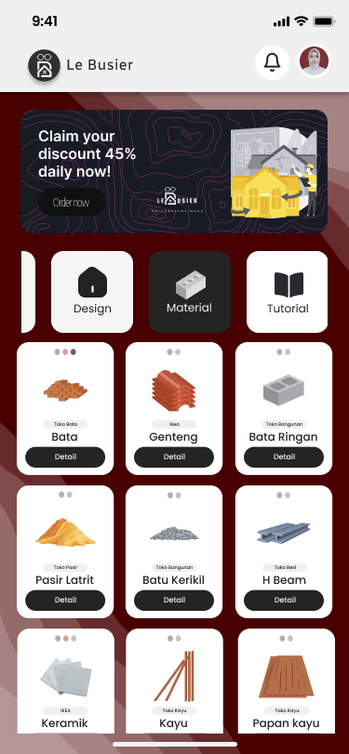
Acceptance Criteria
45
Positive Case
Given | When | Then | User Interface
User open materials menu | User can press the button material menu to open the material store in the application | The application displays recommended material sales features through collaboration with well-known partners

Slide 58


Slide 59
Follow up
10
Ensure the user interface of the Lebusier application remains simple and intuitive. Through clearer design improvements and easy-to-understand guides, we aim to make users, especially those like Meylinda, feel more comfortable and confident in using every feature of the app. Improve communication features between users and builders. These steps include facilitating more efficient dialogue, providing options for Q&A, and ensuring that users can easily communicate their preferences and questions to construction professionals.

Slide 60

UXJourney
the
The process to optimize your resource for the quality User Requirement
From Developer for Developer

